Slide 1

Predictive Analytics & Empirical Finance LOGISTIC REGRESSION (PAYMENT STATUS PREDICTION)
Presented by
Nima
Arushi

Slide 2
CONTENT
Assignment No: | Name
29 | Encoding dataset for Logistic Regression
30 | Training and Testing a Logistic Regression Model
31 | Odds Ratio

Slide 3
LOGISTIC REGRESSION
Logistic regression is a statistical method used in binary classification problems.
It is used when the output variable can take on only two possible values, such as:
0 or 1
Yes or No
Unlike linear regression, which predicts a continuous value, logistic regression predicts the probability of a particular class.
It is commonly used in situations where the decision involves a yes/no outcome.

Slide 4
Example of Logistic Regression:
A company wants to predict if a user will purchase a product (Yes = 1, No = 0) based on:
Age
Income
Time spent on website
Number of products viewed
Using logistic regression, the model estimates the probability that a customer will make a purchase. If the probability is greater than 0.5, the prediction is "Yes", otherwise "No".

Slide 5
Difference between Multiple Regression and Logistic Regression
Feature | Logistic Regression | Multiple Regression
Purpose | Classification | Prediction
Output Type | Categorical (e.g., Yes/No, 0/1) | Continuous (e.g., price, age, temperature)
Equation Form | Uses sigmoid/logit function | Linear equation
Output Value | Probability (0 to 1) | Numeric value (e.g. 75.6)
Independent Variables | categorical | usually continuous
Example Use Case | Predict if customer will buy (Yes/No) | Predict customer's income in dollars
Graph Shape | S-shaped curve | Straight line

Slide 6
Logistic regression Prepare the data
Assignment 29: Use binary and ordinal encoding to make the variables readable by the logistic regression method

Slide 7
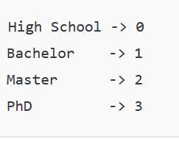
Encoding dataset for Logistic Regression Assignment 29
Three methods of coding:
Binary (Dummy) Encoding (for nominal categories)
Male → 0
Female → 1
This works when a categorical variable has only two levels.
One-Hot Encoding (for more than two categories)
Example: "Education Level" (High School, Bachelor’s, Master’s, PhD)
We create separate binary variables:
High School → (1, 0, 0, 0)
Bachelor’s → (0, 1, 0, 0)
Master’s → (0, 0, 1, 0)
PhD → (0, 0, 0, 1)
In practice, we drop one category to avoid the dummy variable trap (multicollinearity).
Ordinal Encoding (for ordered categories)
Example: If "Satisfaction Level" is Low, Medium, High, we can assign:
Low → 1; Medium → 2; High → 3
This approach is valid only if the categories have a natural order.

Slide 8
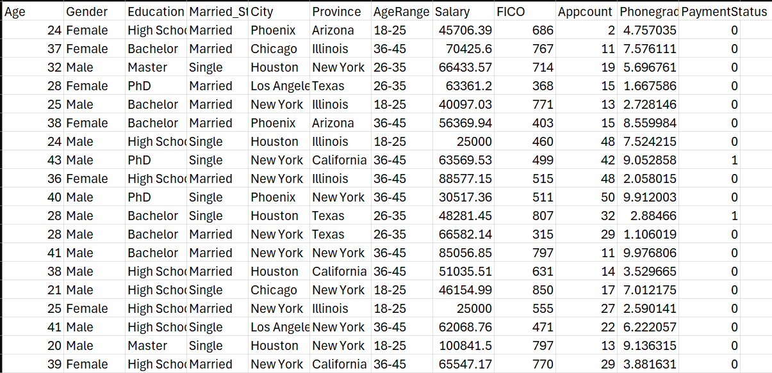
Original dataset given

Slide 9
Python Code
import pandas as pd import category_encoders as ce # Step 1: Load your dataset df = pd.read_csv("") # Replace with your actual file path # Step 2: Ordinal encoding for Education and AgeRange ordinal_encoder = ce.OrdinalEncoder(cols=['Education', 'AgeRange']) df = ordinal_encoder.fit_transform(df) # Step 3: Encode Gender and Married_Status using binary mapping df['Gender'] = df['Gender'].map({'Male': 0, 'Female': 1}) df['Married_Status'] = df['Married_Status'].map({'Single': 0, 'Married': 1}) # Step 4: Binary encoding for City and Province binary_encoder = ce.BinaryEncoder(cols=['City', 'Province']) df = binary_encoder.fit_transform(df) # Step 5: Preview the encoded dataframe print(df.head())
# Step 6: Save to new Excel file for easy observation df.to_csv(" ", index=False)

Slide 10
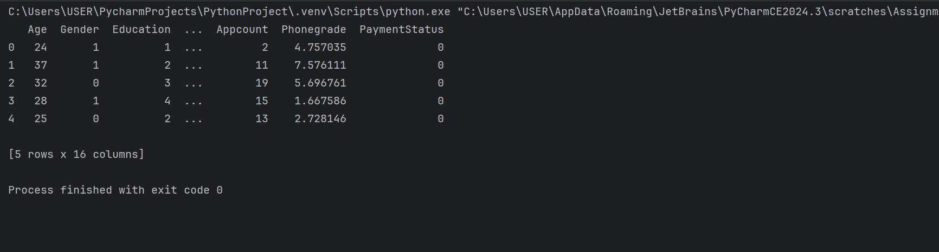
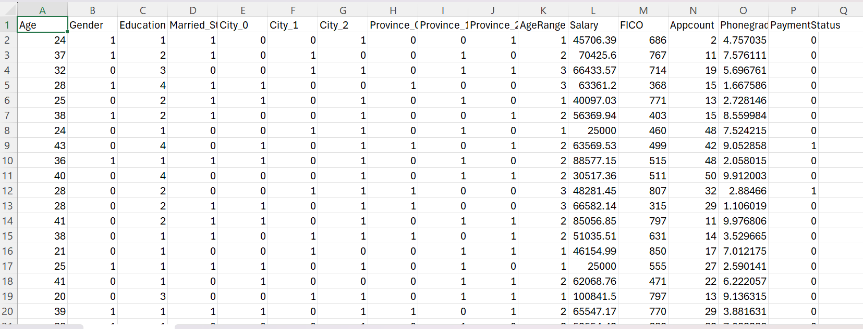
Result
In python:
In excel:

Slide 11
Interpretation
Used Binary and Ordinal Coding
Categorical variables must be converted into numerical form to make the model understand and process them correctly.
Correct encoding ensures that the model captures true relationships without introducing bias or misinterpretation.

Slide 12
Logistic regression Fit the model
Assignment 30: Fit a logistic regression model to predict the payment status.
Please use 90% of the data to train the model and 10% of the model to test the model.
Notes:
Start with a test and training set (90%)
PA_GLM.py

Slide 13
Training and Testing a Logistic Regression Model Assignment 30
Training Data (90%):
We will use 90% of our dataset to train the logistic regression model.
We will be learning the relationships between the input features (independent variables) and the target variable (payment status, which might be 0 or 1) through this.
Testing Data (10%):
The remaining 10% of the data will be set aside and not used during the model training phase.
This testing set is used to evaluate how well the model generalizes to new, unseen data. We put this data into the model after it’s trained to check how accurate its predictions are.

Slide 14
Python Code
import pandas as pd import statsmodels.api as sm from sklearn.preprocessing import StandardScaler from sklearn.linear_model import LogisticRegression from sklearn.model_selection import train_test_split from sklearn.metrics import classification_report, confusion_matrix, accuracy_score # Step 1: Load the 29th assignment excel path df = pd.read_csv("") # Step 2: Define feature variables (X) and target variable (y) # Assuming 'payment status' is the column to predict X = df.drop('PaymentStatus', axis=1) y = df['PaymentStatus'] # Step 3: Split the data into train and test sets (90% train, 10% test) X_train, X_test, y_train, y_test = train_test_split(X, y, test_size=0.10, random_state=42)
# Step 4: Scale the data scaler = StandardScaler() X_train_scaled = scaler.fit_transform(X_train) X_test_scaled = scaler.transform(X_test) # Step 5: Convert scaled data back to DataFrame to retain column names
X_train_scaled_df = pd.DataFrame(X_train_scaled, columns=X.columns)
X_train_scaled_df = sm.add_constant(X_train_scaled_df)

Slide 15
Python Code
# Step 6: Predict on the test set y_pred = model.predict(X_test_scaled) # Add constant (intercept) X_train_sm = sm.add_constant(X_train_scaled) # Fit model using statsmodels model = sm.Logit(y_train, X_train_sm).fit() # Print summary print(model.summary()) # Step 7: Evaluate the model print(confusion_matrix(y_test, y_pred)) print(classification_report(y_test, y_pred)) print(accuracy_score(y_test, y_pred)) # Create results dataframe results_df = pd.DataFrame({ 'Actual': y_test, 'Predicted': y_pred }) results_df.reset_index(drop=True, inplace=True) # Save to new Excel file for easy observation results_df.to_csv("", index=False) print("Results saved successfully.") print()

Slide 16
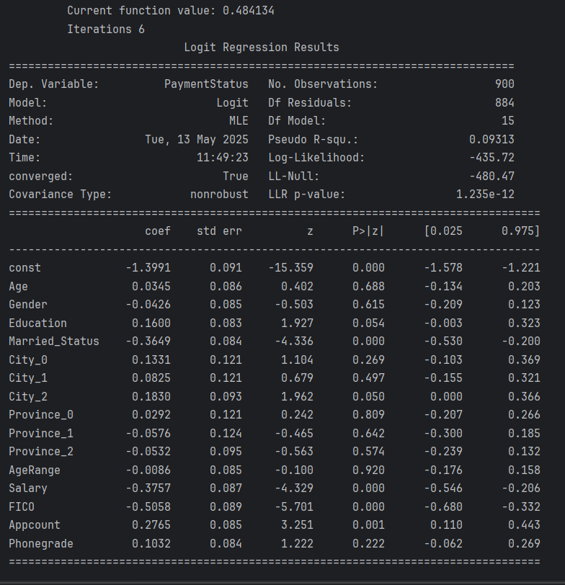
Result
In python:

Slide 17
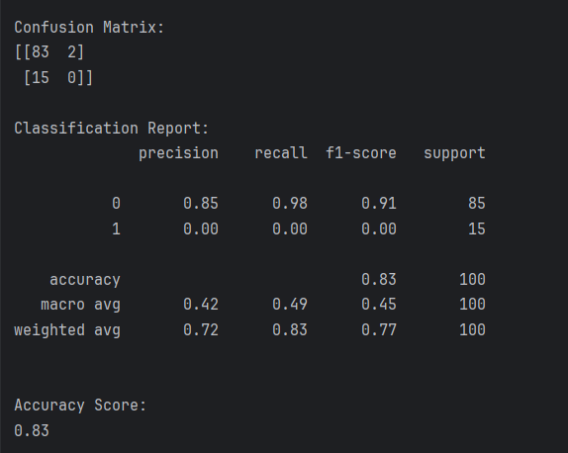
Result
2. In python

Slide 18
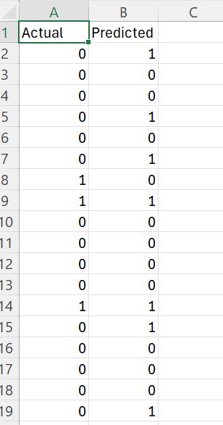
Result
2. In excel:

Slide 19
Interpretation
Test Set Size: 18 records (rows 2 to 19).
Correct Predictions:
True Negatives (0 predicted as 0): 8
True Positives (1 predicted as 1): 2
3. Incorrect Predictions:
False Positives (0 predicted as 1): 5
False Negatives (1 predicted as 0): 3
it often predicted "paid" when it wasn't.
Splitting data helps avoid overfitting and ensures the model can generalize to new data.
Fitting the model creates a mathematical relationship between predictors and the outcome.

Slide 20
Logistic regression Odds Ratio
Assignment 31: Interpret the coefficients using the odds ratio.

Slide 21

Odds Ratio Assignment 31
The odds is a way to express the likelihood of an event happening compared to it not happening.
Odds=$\frac{P\left(Success\right)}{1−P\left(Success\right)}$
Where: P(Success) is the probability of the event occurring,
1−P(Success) is the probability of the event not occurring.
If P(Success)=0.8,
then: Odds=0.8/(1−0.8)
=0.8/0.2
=4
The odds of success are 4 to 1 (meaning success is 4 times more likely than failure).

Slide 22

Odds Ratio Assignment 31
Odds ratio measures the impact on the odds of a one-unit increase in only one of the independent variables.
Odds Ratio= $\frac{Odds1}{Odds0}$
Odds Ratio=e^{β}
If β=0: No effect on the odds.
If e^{β}>1: Increases the odds of the event.
If e^{β}<1: Decreases the odds of the event.

Slide 23
Python Code
import pandas as pd import numpy as np from sklearn.linear_model import LogisticRegression from sklearn.model_selection import train_test_split from sklearn.preprocessing import StandardScaler # Step 1: Load your 29th assignment excel path here df = pd.read_csv("") # Step 2: Define features (X) and target (y) X = df.drop("PaymentStatus", axis=1) y = df["PaymentStatus"] # Step 3: Train-test split X_train, X_test, y_train, y_test = train_test_split(X, y, test_size=0.10, random_state=42) # Step 4: Feature scaling scaler = StandardScaler() X_train_scaled = scaler.fit_transform(X_train)
# Step 5: Fit logistic regression model = LogisticRegression(max_iter=2000, class_weight='balanced') model.fit(X_train_scaled, y_train)

Slide 24
Python Code
# Step 6: Interpret coefficients using odds ratio feature_names = X_train.columns coefficients = model.coef_[0] odds_ratios = np.exp(coefficients) odds_df = pd.DataFrame({ 'Feature': feature_names, 'Coefficient': coefficients, 'Odds Ratio': odds_ratios }).sort_values(by='Odds Ratio', ascending=False) print(odds_df) # Step 7: Save to new Excel file for easy observation odds_df.to_csv("", index=False)

Slide 25
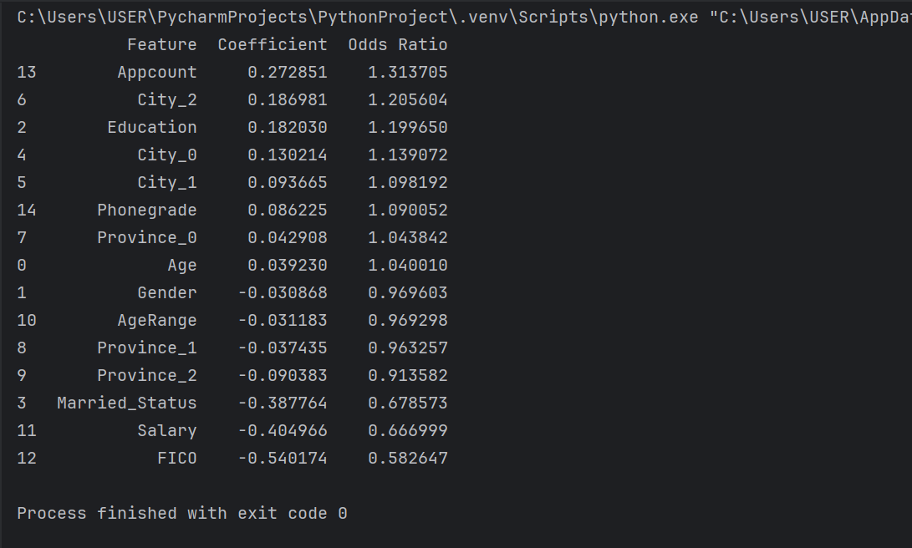
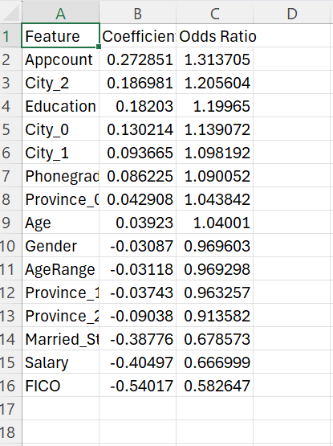
Result
In python:
In excel:

Slide 26
Interpretation
Features that increase the odds of non-payment:
Appcount (1.31): Each additional application increases the odds of non-payment by 31%.
Education (1.20): Higher education level is associated with a 20% increase in odds of non-payment.
City_2 (1.21) and City_0 (1.14): Living in these cities slightly increases the risk of non-payment.
2. Features that decrease the odds of non-payment:
FICO Score (0.58): A higher FICO score reduces the odds of non-payment by 42%, making it one of the most influential predictors.
Salary (0.67): Higher income reduces the odds by approximately 33%.
Married Status (0.68): Being married appears to lower the risk of non-payment.

Slide 27
Summarizing
Assignment 29 – Data Encoding for Logistic Regression
- encoding categorical variables using binary and ordinal encoding methods to prepare the dataset for logistic regression.
-This helps convert qualitative data into a numerical format suitable for modeling.
Assignment 30 – Model Fitting -This involved fitting a logistic regression model to predict payment status. The task required using 90% of the dataset for training and 10% for testing to evaluate model performance.
Assignment 31 – Odds Ratio -interpreting the fitted model’s coefficients using the odds ratio, which helps explain the influence of each predictor variable on the likelihood of the target event occurring.

Slide 28


